Slide 1
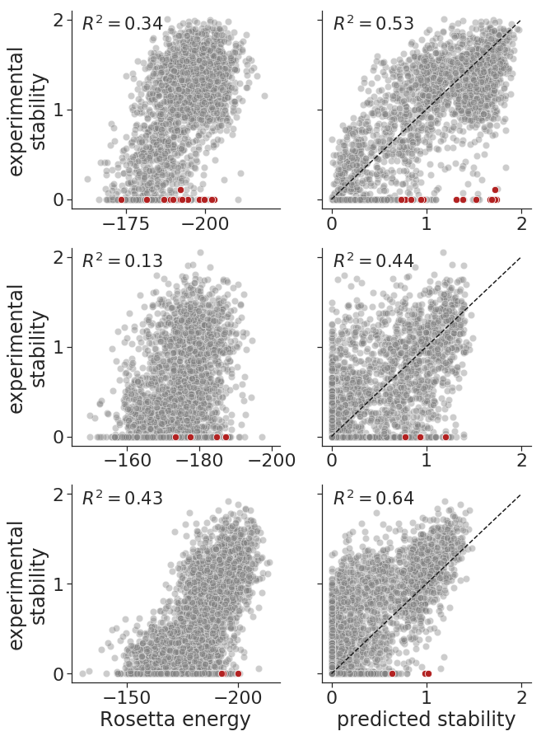
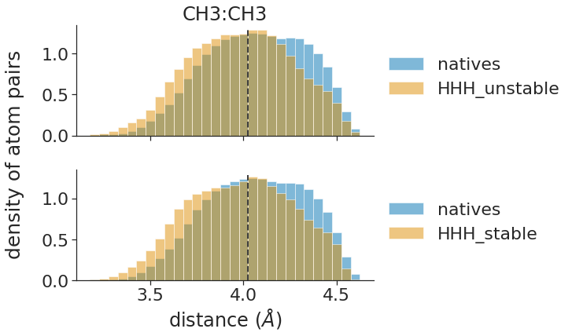
A
B
C
D
amino acid
stability
site in protein
E
F
V11
I21
(C – C distances)
density
crystal structures of natives
unstable designs (n = 209)
density
crystal structures of natives
stable designs (n = 1041)
C
2.6 Å
H
C
2.8 Å
Figure 2. Deep mutational scanning identified single amino-acid mutations that rescued failed protein designs.
Notes:
To do:
* in B, draw a schematic of the DMS experiment showing WT gene, mutant genes, and stable/unfolded proteins
in E, replace with sticks that show distances between atoms
in F, have plots for H-C, C-C, and H-H

Slide 2
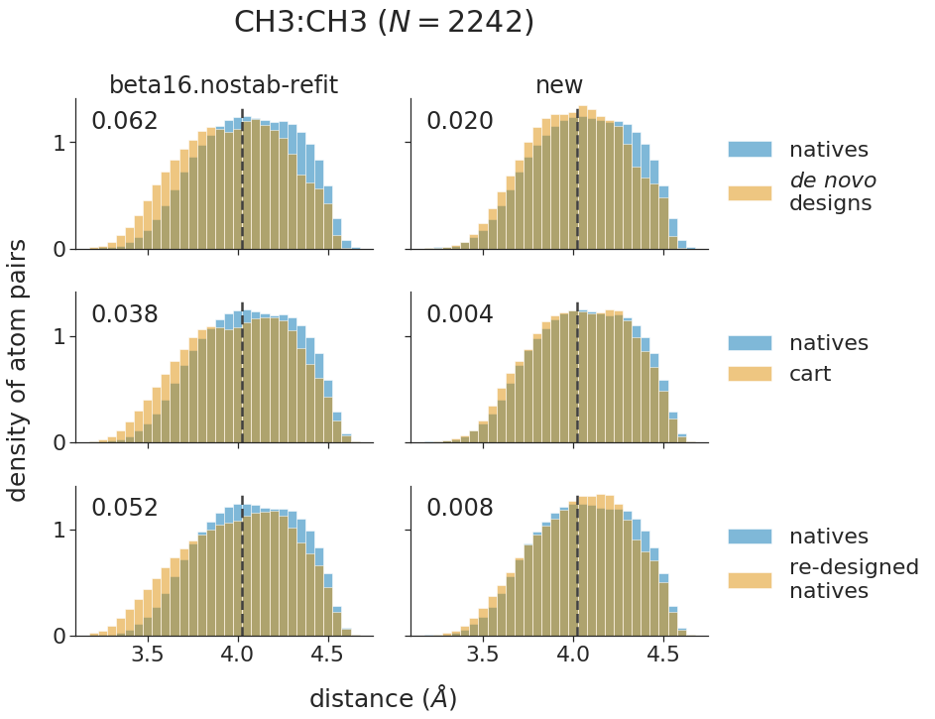
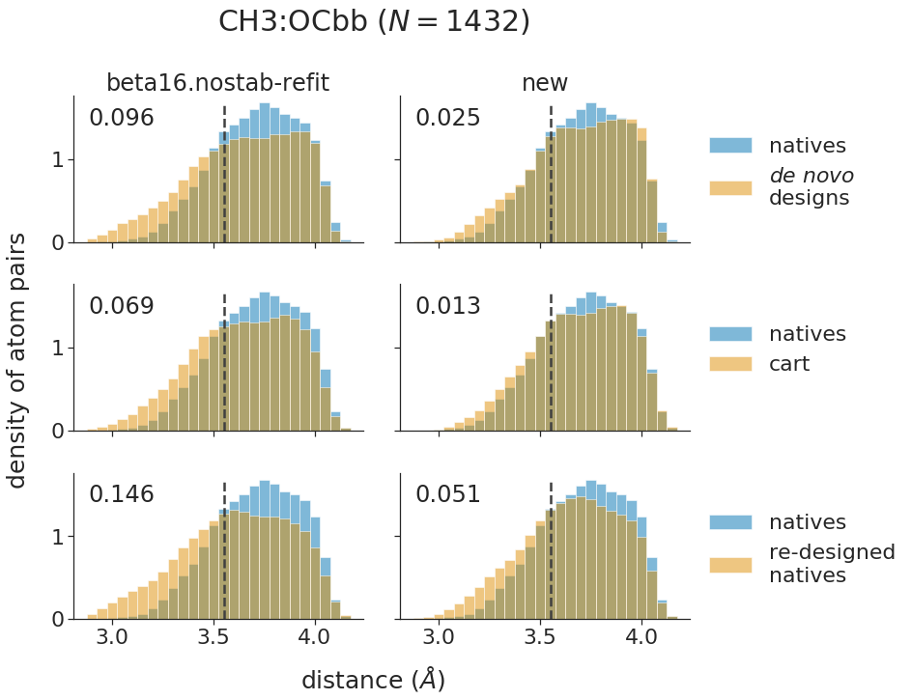
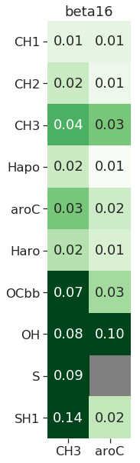
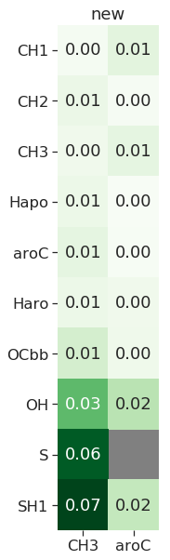
A
CH3:CH3
CH3:OCbb
B
Figure 3. Rosetta introduces steric clashes when relaxing and designing proteins

Slide 3
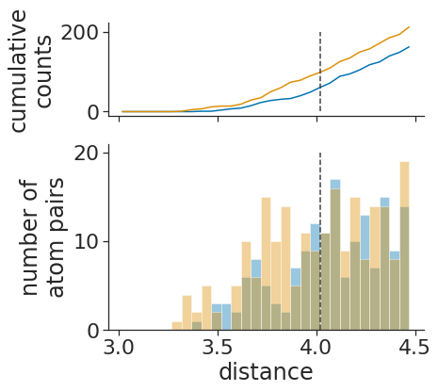
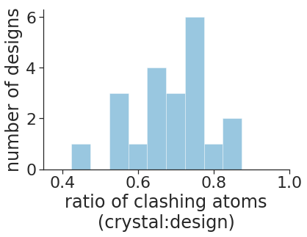
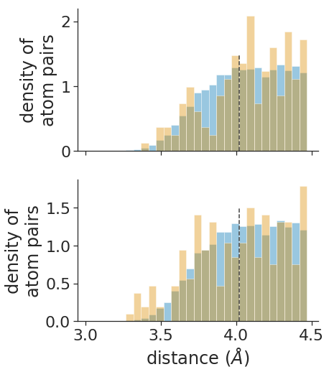
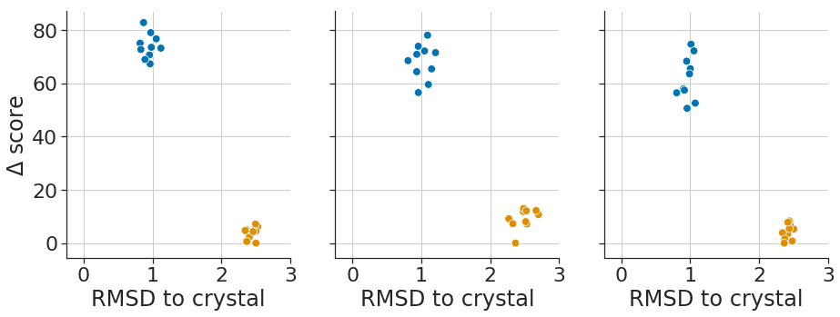
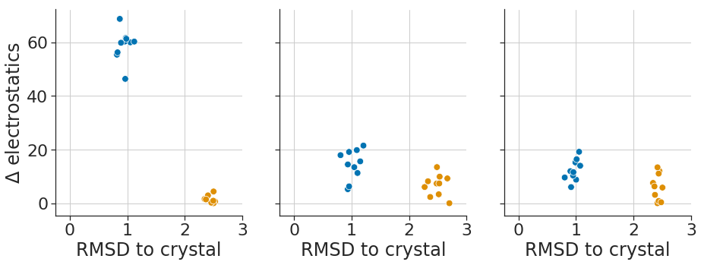
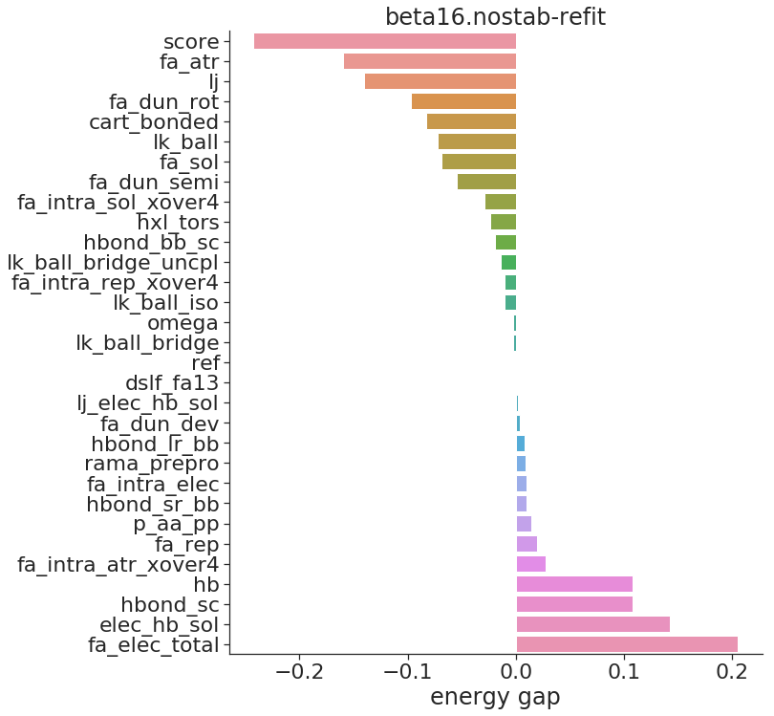
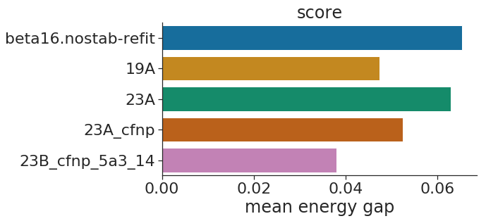
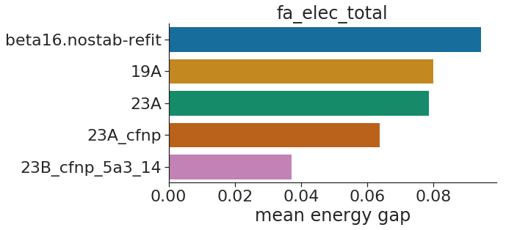
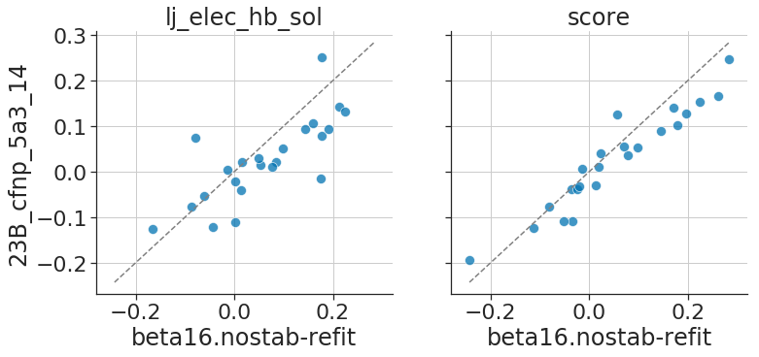
A
B
C:C (hydrophobic side chains)
C
design model
crystal structure
99
61/99 = 0.62
61
design
crystal
3.9 A
3.3 A
design
natives
- depth dependence
+ depth dependence
- depth dependence
+ depth dependence
relaxed from crystal
relaxed from design

Slide 4
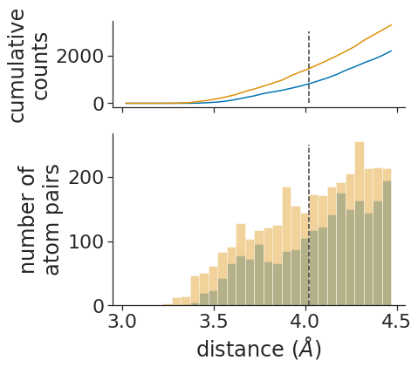
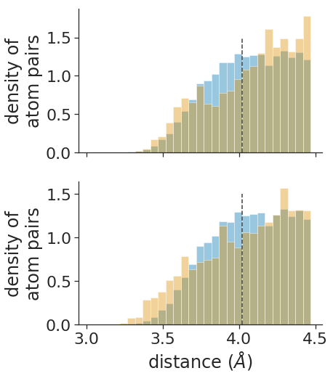
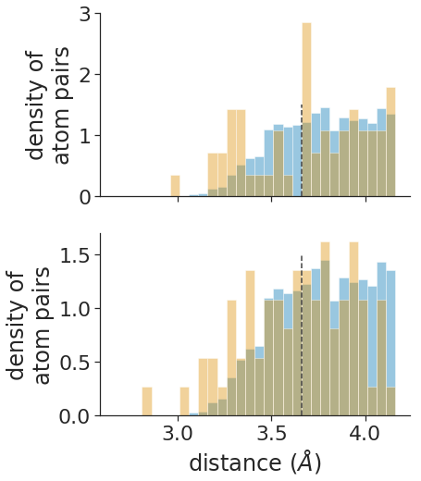
design
crystal
A B
crystal
design
natives
carbon : backbone oxygen
design
natives

